Slide 1
SOFT COMPUTING
Problem Solving Techniques
Hard Computing – Deals with precise models where accurate solutions are achieved quickly
Symbolic logical reasoning (Traditional AI)
Traditional mathematical modeling and search
Soft Computing – Deals with approximate models and give solution to complex problems
Introduced by Prof. Lotfi Zadeh with objective of exploting the tolerance for imprecision, uncertainty and partila truth to achieve tractability, robustness, low solution cost and better rapport with reality.
Ultimate goal is to be able to emulate the human mind as closely as possible.

Slide 2
SOFT COMPUTING
Soft Computing involves
Neural Networks – Processing device, either an algorithm or hardware whose design was inspired by the design and functioning of animal brain and componets
GA – Reminiscent of sexual reproduction on which the genes of two parents combine to form those of their children
Fuzzy logic – By Prof. Lotfi Zadeh (Uni. California) – An organized method for dealing with imprecise data is called FL
The data are considered as fuzzy sers

Slide 3
SOFT COMPUTING
Neural Networks – Processing device, either an algorithm or hardware whose design was inspired by the design and functioning of animal brain and components
ANN – defined as information processing model that is inspired by the way biological nervous system, such as brain, process information
Model tries to replicate the functions of brain
GA – Reminiscent of sexual reproduction on which the genes of two parents combine to form those of their children
Fuzzy logic – By Prof. Lotfi Zadeh (Uni. California) – An organized method for dealing with imprecise data is called FL
The data are considered as fuzzy sers

Slide 4
Artificial Neural Networks
Neural Networks – objective of the NN research is to develop a computational device for modeling the brain to perform various computational task at a faster rate than the traditional system
It comprise of three main layers
Input layer: The input layer accepts all the inputs that are provided by the programmer.
Hidden layer: In between the input and output layer, there is a set of hidden layers on which computations are performed that further results in the output.
Output layer: After the input layer undergoes a series of transformations while passing through the hidden layer, it results in output that is delivered by the output layer.

Slide 5
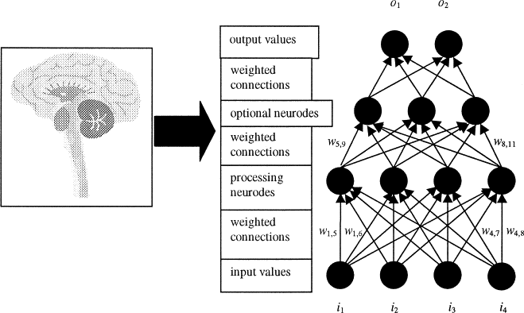

Slide 6
Artificial Neural Networks
ANN – Performs various tasks such as
pattern matching and classification,
approximation function,
approximation,
vector quantization and
data clustering

Slide 7
Artificial Neural Networks
ANN – Possess large number of highly interconnected processing elements called nodes or units or neurons which usually operate in parallel and are configured in regular infrastructures
Each neuron is connected with other by a connection link
Each connection link is associated with weights which contains the information about the input signal
This information is used by neuron net to solve a particular problem
ANN behavior is characterized by their ability to learn, recall and generalize training pattern or data similar to that of human brain
ANN processing elements are called neurons or artificial neuron
Each neuron has an internal state of its own, is called activation or activity level of neuron which is the fn. of the i/p the neuron receives

Slide 8
Instead of directly getting into the working of Artificial Neural Networks, lets breakdown and try to understand Neural Network's basic unit, which is called a Perceptron.
So, a perceptron can be defined as a neural network with a single layer that classifies the linear data. It further constitutes four major components, which are as follows;
Inputs
Weights and Bias
Summation Functions
Activation or transformation function
Linear activation function and Non linear activation function

Slide 9
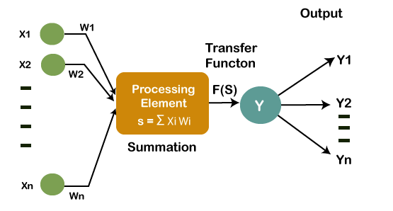
Activation function
Y(input)= +x1wI1+.x2w2+…
Y(out)= function(Yin)

Slide 10
Biological Neural Networks
Human brain consist of huge number of neuron, approximately 10 power 11 with interconnection
Three main parts
Soma or Cell body – Where the cell nucleus is located
Dendrites – Where the nerve is connected to the cell body – Are tree-like networks made of nerve fiber connected to the cell body
Axon – Which carries the impulses of the neuron – An axon is a single long connection extending from the cell body and carrying signals from the neuron – The end of the axon splits in to fine strands
Each strand terminates in to a small bulb like organ called Synapse – through synapse the neuron introduces signals to other nearby neurons, the receiving end of the synapse on the nearby neuron can be found both on dendrites and on the cell body- 10 power 4 of synapse per neuron in the human brain

Slide 11
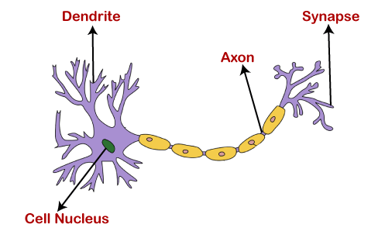
Cell Body (Soma)

Slide 12
The dendrites will act as a receiver that receives signals from other neurons, which are then passed on to the cell body.
The cell body will perform some operations that can be a summation, multiplication, etc. After the operations are performed on the set of input, then they are transferred to the next neuron via axon, which is the transmitter of the signal for the neuron.
Electric pulses are passed b/w synapse and dendrites – this type of signal transmission involves a chemical process in which specific transmitter substances are released from the sending side of the junctions. This releases decrease or increase in the electric potential inside the body of the receiving cell

Slide 13
If the electric potential reaches threshold then the receiving cell fires and a pulse or action potential of fixed strength and duration is sent out through axon to the synaptic junction of the other cell,
After firing the cell has to wait for a period of time is called Refractory Period before it can fire again. The Synapse are said to be
Inhibitory – let passing impulses hinder the firing of the receiving cell
Excitatory – let passing impulses cause the firing of the receiving cell

Slide 14
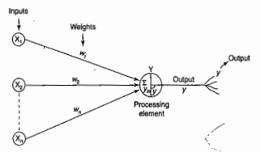
Biological Neuron | Artificial Neuron
Cell | Neuron
Dendrites | Weights or Interconnection
Axon | Output

Slide 15
Criteria | Biological Neuron | Artificial Neuron
Speed | Milliseconds | Nanoseconds
Processing | Massive Parallel operation simultaneously | Parallel operation but faster
Size and Complexity | 10^11 and interconnection is 10^15 Complexity is more | Based on the chosen application and the n/w designer
Storage capacity (memory) | Stores the info. in interconnection or in synapse strength | Contiguous memory locations`
Tolerance | Fault tolerant capability | No fault tolerance
Control Mechanism | No control unit for the brain | Control unit in CPU

Slide 16
Characteristics of ANN
It is neurally implemented mathematical model
Large number of highly interconnected processing elements called neurons in an ANN
The interconnection with their weighted linkages hold the informative knowledge.
Input signal arrives at processing elements through connections and connecting weights
The processing elements of the ANN have the ability to learn, recall and generalize form the given data by suitable assignment of adjustment of weights
The computational power can be demonstrated only by the collective behavior of neurons and it should be noted that no single neuron carries specific information

Slide 17
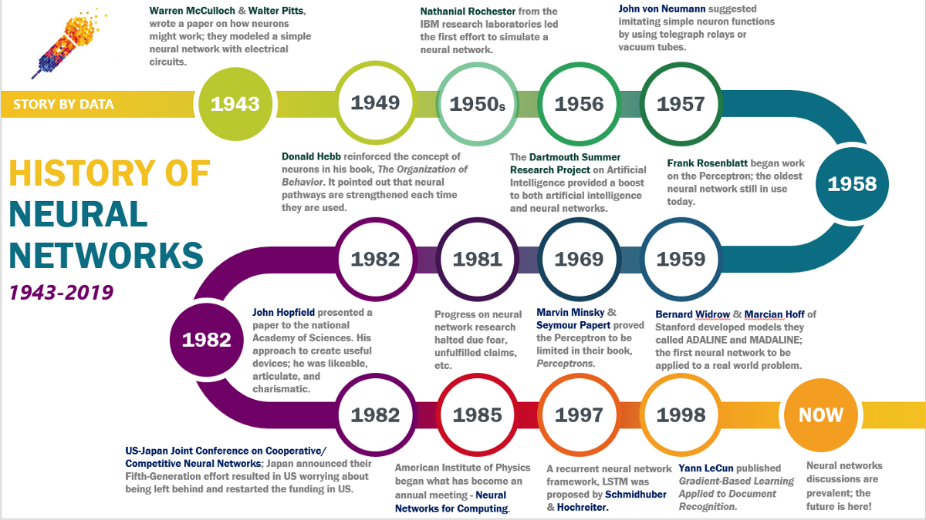

Slide 18
Basic Models of ANN
Specified by three basic entities
The models synaptic interconnections
The training or learning rule adopted for updating or adjusting connection weights
Their activation functions
Connections: ANN has set of highly interconnected processing elements called neurons
The interconnection with their weighted linkages hold the informative knowledge with itself or others.
Arrangements and geometry of their interconnections are essential and the function each processing element should be noted
The arrangement of neuron to form layers and the connection pattern formed within and b/w layers is called network architecture

Slide 19
Basic Models of ANN
There are five basic network connections
Single layer feed-forward
Multi layer feed-forward
Single node with its own feedback
Single layer recurrent network
Multi layer recurrent network

Slide 20
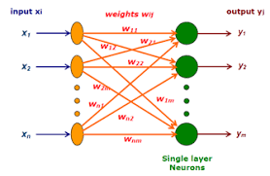
Basic Models of ANN
Single layer feed-forward network - The simplest kind of neural network is a single-layer perceptron network, which consists of a single layer of output nodes; the inputs are fed directly to the outputs via a series of weights. In this way it can be considered the simplest kind of feed-forward network.

Slide 21
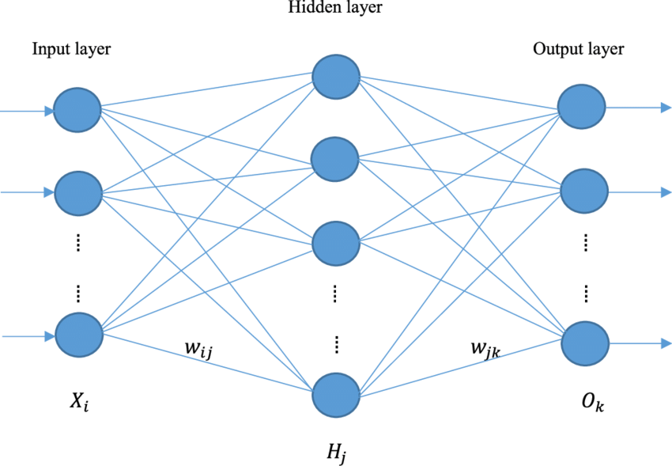
Basic Models of ANN
Multi layer feed-forward network - A multilayer feedforward neural network is an interconnection of perceptrons in which data and calculations flow in a single direction, from the input data to the outputs. The number of layers in a neural network is the number of layers of perceptrons.

Slide 22
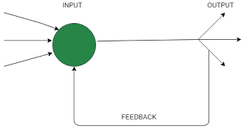
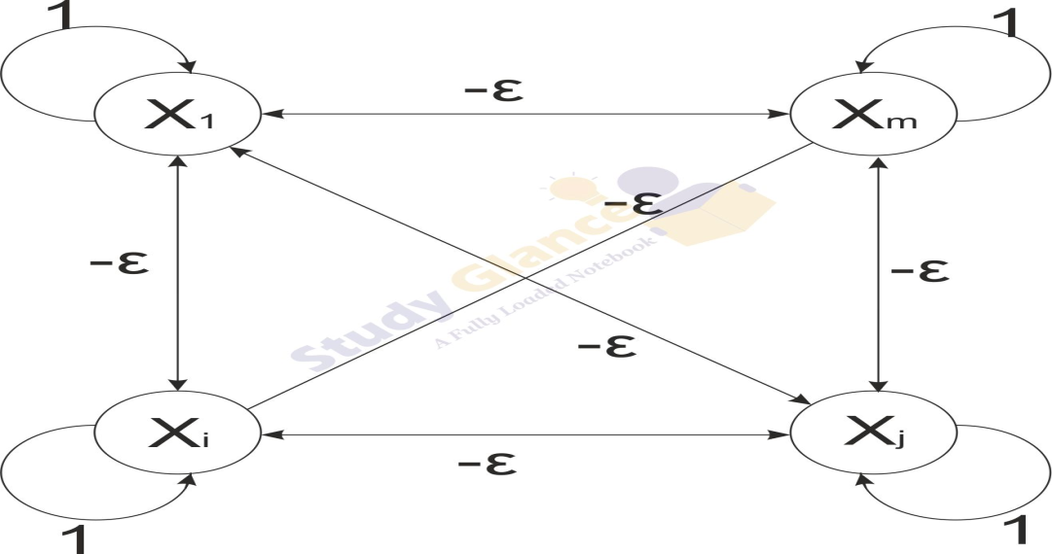
Basic Models of ANN
Single node with its own feedback - A network is said to be a feed forward network if no neuron in the output layer is an input to a node in the same layer or in the preceding layer. When outputs can be directed back as inputs to same or preceding layer nodes then it results in the formation of feedback networks.

Slide 23
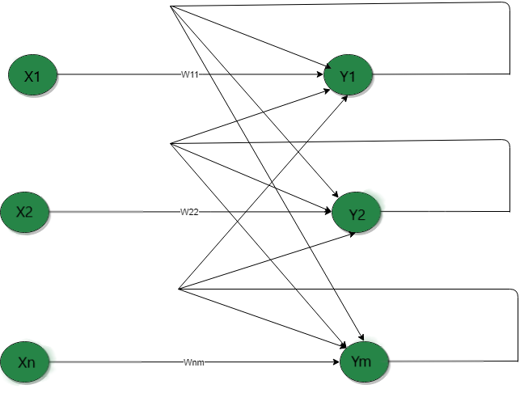
Basic Models of ANN
Single layer recurrent network - A recurrent neural network (RNN) is a type of artificial neural network which uses sequential data or time series data. - A single-layer network with a feedback connection in which the processing element’s output can be directed back to itself or to another processing element or both. RNNs can use their internal state (memory) to process sequences of inputs.

Slide 24
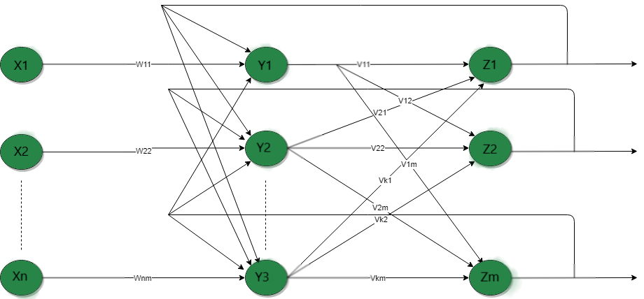
Basic Models of ANN
Multi layer recurrent network -In this type of network, processing element output can be directed to the processing element in the same layer and in the preceding layer forming a multilayer recurrent network. They perform the same task for every element of a sequence, with the output being dependent on the previous computations. Inputs are not needed at each time step. The main feature of a Recurrent Neural Network is its hidden state, which captures some information about a sequence.

Slide 25
Basic Models of ANN
Learning: main property of ANN is capability of learn – learning / Training is a process by means of which a NN adapts itself to a stimulus by making parameter adjustments, resulting in the production of desired response
Two kinds of learning
Parameter learning - It update the connection weights in neural net
Structure learning – Focus on the change in the network structure
General classification of ANN
Supervised learning
Unsupervised learning
Reinforcement learning

Slide 26
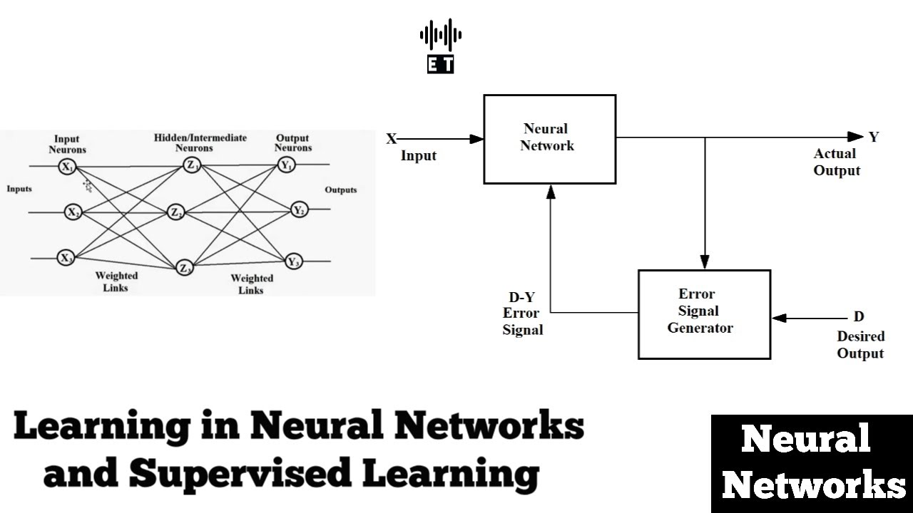
Basic Models of ANN
Supervised learning - As the name suggests, supervised learning takes place under the supervision of a teacher. This learning process is dependent.
During the training of ANN under supervised learning, the input vector is presented to the network, which will produce an output vector. This output vector is compared with the desired/target output vector. The input vector along with the target vector is called training pair.
An error signal is generated if there is a difference between the actual output and the desired/target output vector. On the basis of this error signal, the weights would be adjusted until the actual output is matched with the desired output.

Slide 27
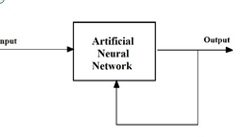
Basic Models of ANN
Unsupervised learning - As the name suggests, this type of learning is done without the supervision of a teacher. This learning process is independent.
During the training of ANN under unsupervised learning, the input vectors of similar type are combined to form clusters. When a new input pattern is applied, then the neural network gives an output response indicating the class to which input pattern belongs.
In this, there would be no feedback from the environment as to what should be the desired output and whether it is correct or incorrect. Hence, in this type of learning the network itself must discover the patterns (Self organizing), features from the input data and the relation for the input data over the output.

Slide 28
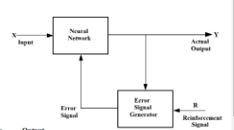
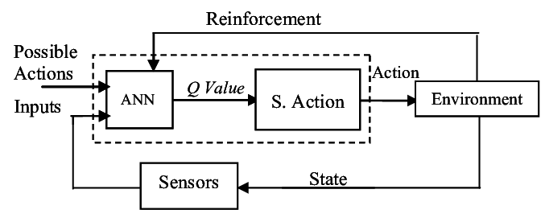
Basic Models of ANN
Reinforcement learning - Reinforcement learning is a goal-directed computational approach where an agent learns to perform a task by interacting with an unknown dynamic environment (learning based on the critic information). During training, the learning algorithm updates the agent policy parameters.(Feedback sent is called reinforcement signal)

Slide 29
The McCulloch-Pitts (Walter Pitts) neuron was the earliest neural network discovered in 1943.
It is usually called as M-P neurons connected by weighted paths
Activation function is binary that is at any time step the neuron may free or may not free
Weight may be excitatory (Positive) or Inhibitory (Negative) and all are entering in to the neuron with same weights
Threshold plays a vital role, if input is greater that threshold the neuron fires and any non zero inhibitory prevent the firing
Mostly used in Logic functions

Slide 30
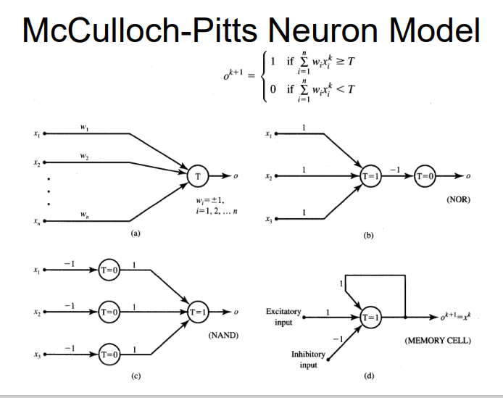

Slide 31


inputs from Xi too Xn possess excitatory weighted connections and inputs from Xn+ 1 m Xn+m possess inhibitory weighted interconnections. Since the firing of ilie output neuron is based upon the threshold, the activation function here is defined as
For inhibition to be absolute, the threshold with the activation function should satisfy the following condition:
No particular training algorithm

Slide 32

Linear separability
ANN does not give an exact solution for a nonlinear problem. However, it provides possible approximate solutions nonlinear problems.
Linear separability, is the concept wherein the separation of the input space into regions is based on whether the network response is positive or negative.
A decision line is drawn to separate positive and negative responses. The decision line may also be called as the decision-making line or decision-support line or linear-separable line.
The necessity of the linear separability concept was felt to classify the patterns based upon their output responses. Generally the net input calculation to the output unit is given as

Slide 33
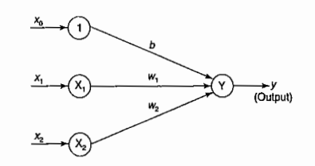
Single layer neural net
Consider a network having positive response in the first quadrant and negative response in all other quadrants (AND function) with either binary or bipolar data, then the decision line is drawn separating the positive response region from the negative response region.

Slide 34
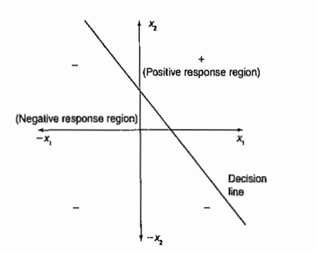

Slide 35
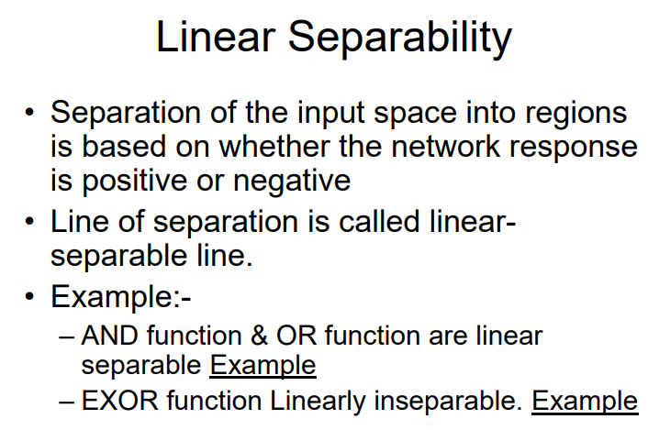

Slide 36

Hebb Network
Donald Hebb stated in 1949, learning rule is the simplest one
The learning in the brain is performed by the change in the synaptic gap
When an axon of cell A is near enough to excite cell B and repeatedly keep firing it, some growth process takes place in one or both cells
According to Hebb rule, weight vector is found to increase proportionately to the product of the input and learning signal.

Slide 37
The Hebb rule is more suited for data than bipolar data. If binary data is used, the above weight updation formula cannot distinguish two conditions namely;
A training pair in which an input unit is "on" and target value is "off.“
A training pair in which both the input unit and the target value are "off.“
The training algorithm is used for the calculation and of weights. The flowchart for the training

Slide 38
